Slide 1
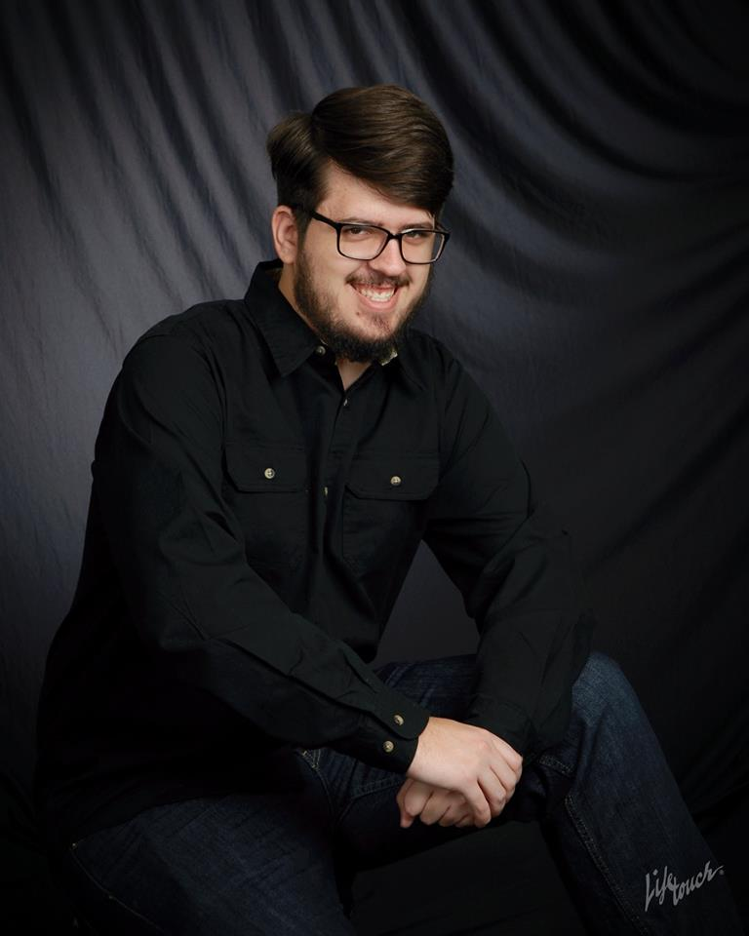
Zachary McKee A Brief History

Slide 2
My origins
I was born October 30th, 1995.
My parents are Todd and Rhonda McKee.
I was born in Flint, MI.
I’ve lived in Michigan my whole life.

Slide 3
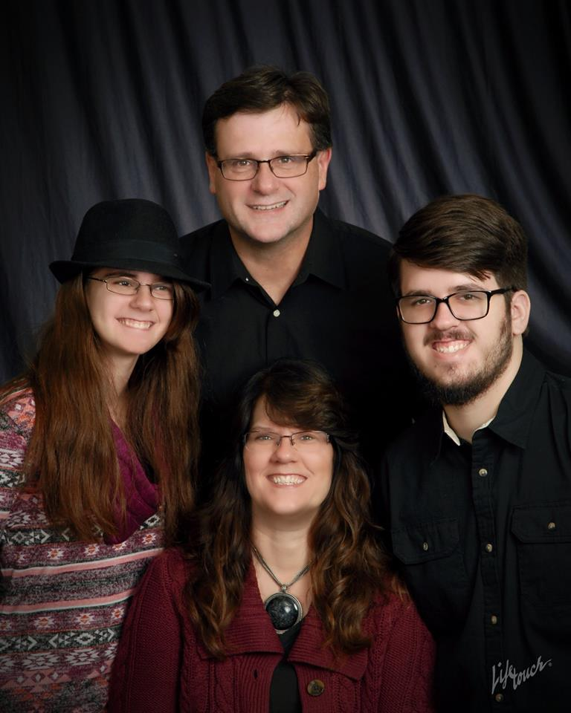
My Family
Dad
Sister
ME
Mom

Slide 4
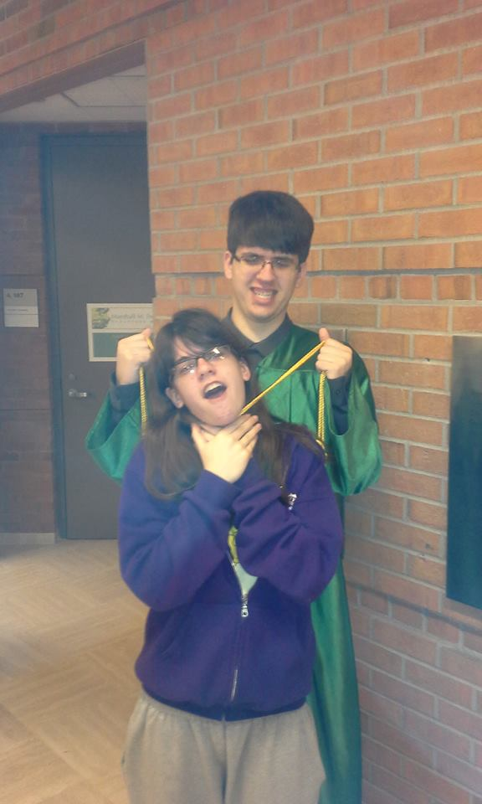
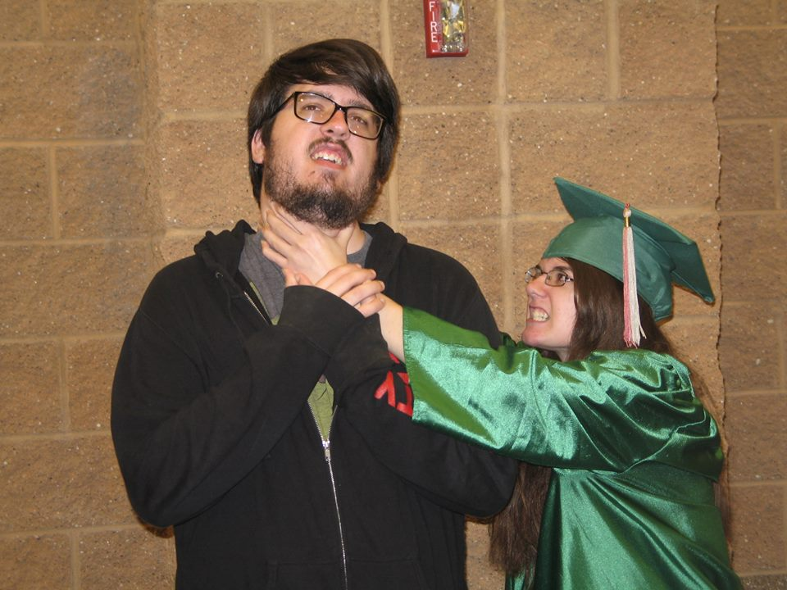
My Sister and I have an … interesting relationship
(2014)
(2017)

Slide 5
As I said, I grew up in Flint

Slide 6

I remember a lot of 90’s stuff

Slide 7
I was surrounded by computers growing up

